Slide 1
Application of Cauchy’s Residue Theorem
(Improper Integral)
Exercise: 7.2

Slide 2
Objective:
To evaluate real valued improper integrals using contour integral method
Methodologies:
Cauchy Residue Theorem and Jordan’s Lemma (a particular case) will be used to evaluate contour integral

Slide 3
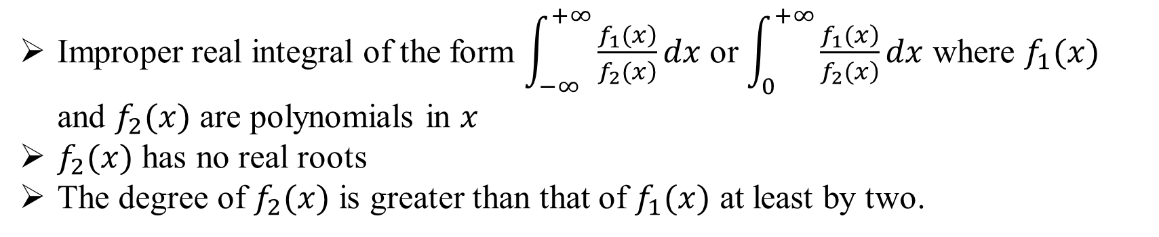
Contour Integral:
A contour and the process of integration along a contour is called contour integration
Conditions for an improper integral to be reduced into contour integral:
Improper real integral of the form $\int_{−∞}^{+∞}{\frac{\left.f_{1}(x\right)}{\left.f_{2}(x\right)}dx}$ or $\int_{0}^{+∞}{\frac{\left.f_{1}(x\right)}{\left.f_{2}(x\right)}dx}$ where $f_{1}(x)$ and $f_{2}(x)$ are polynomials in $x$
$f_{2}(x)$ has no real roots
The degree of $f_{2}(x)$ is greater than that of $f_{1}(x)$ at least by two.

Slide 4
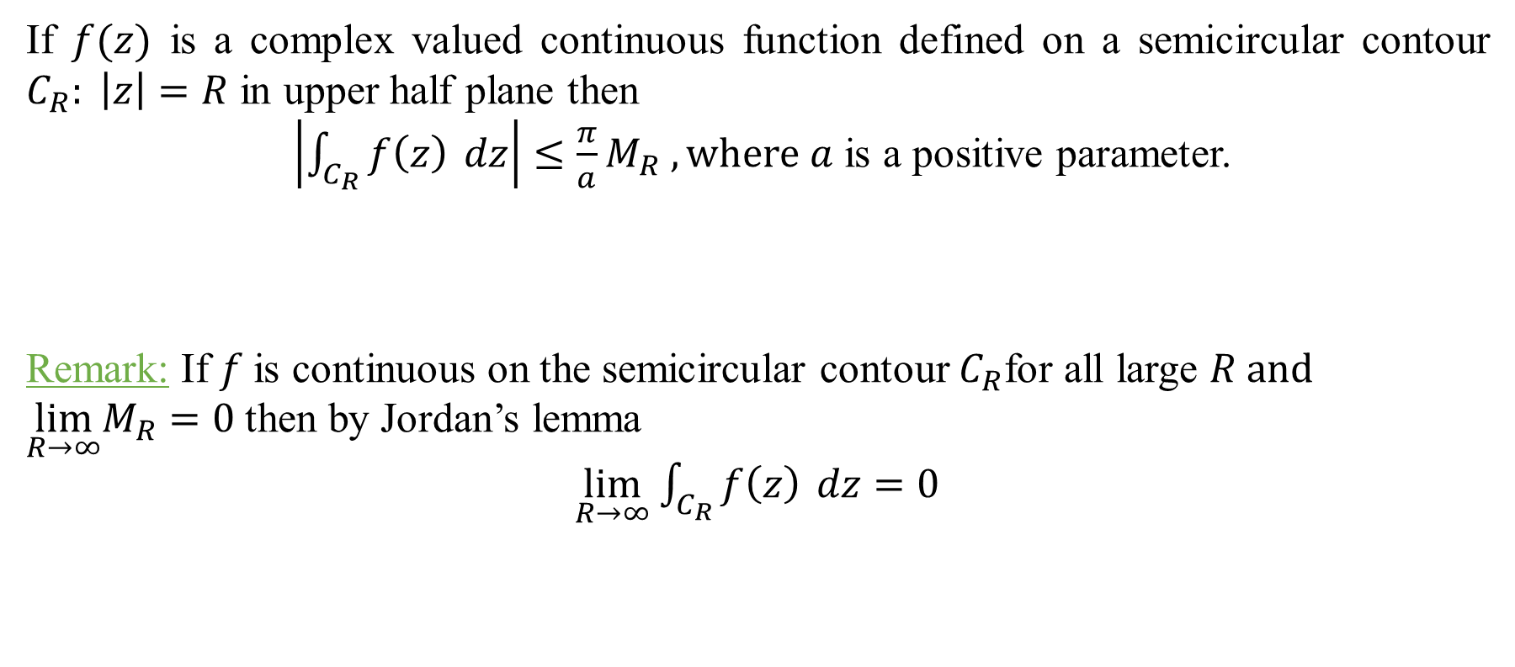
Jordan’s Lemma:
If $f(z)$ is a complex valued continuous function defined on a semicircular contour $C_{R}: \left|z\right|=R$ in upper half plane then
$\left|\int_{C_{R}}{f\left(z\right)} dz\right|$ $≤\frac{π}{a}M_{R} , where a$ is a positive parameter.
Remark: If $f$is continuous on the semicircular contour $C_{R}$for all large $R and$
$\lim_{R→∞}M_{R}=0$ then by Jordan’s lemma
$\lim_{R→∞}$ $\int_{C_{R}}{f\left(z\right)} dz=0$

Slide 5
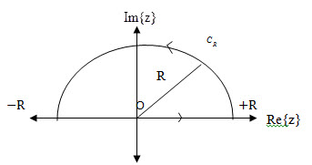
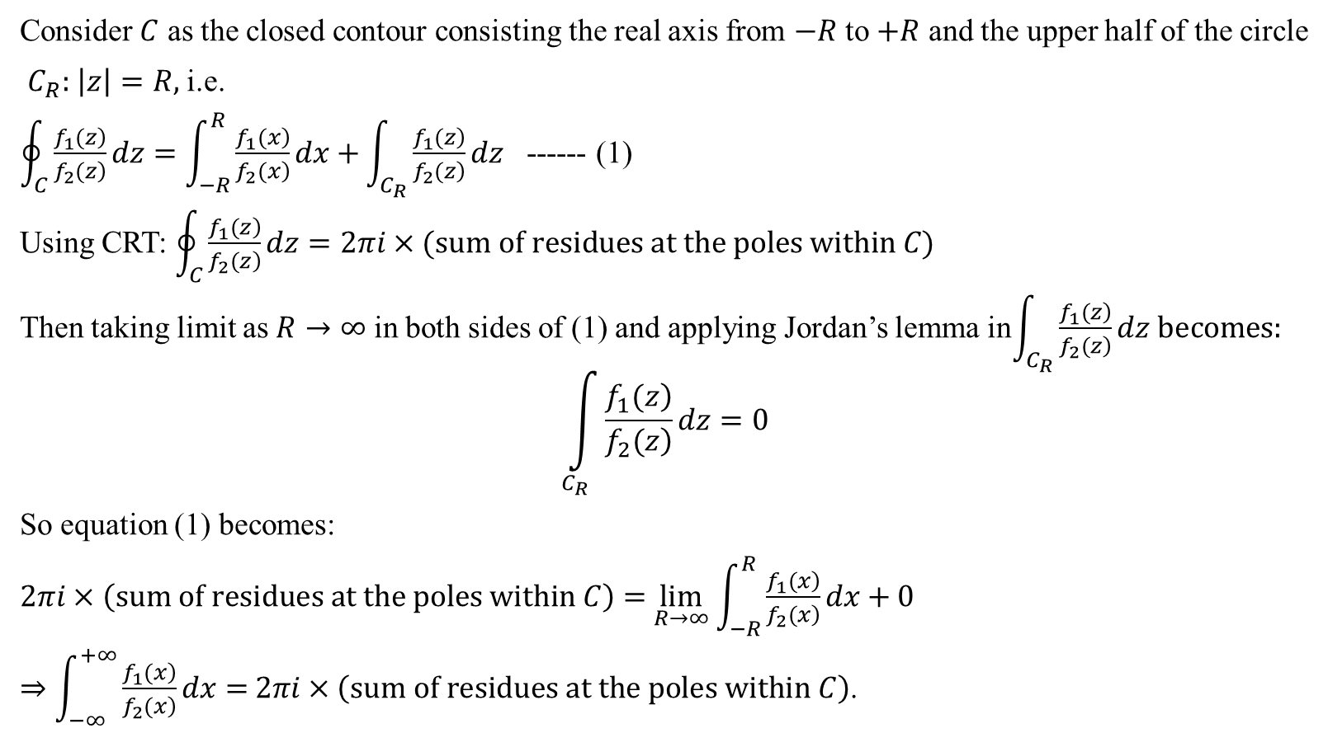

Procedure to evaluate improper integral $\int_{−∞}^{+∞}{\frac{\left.f_{1}(x\right)}{\left.f_{2}(x\right)}dx}$ :
Consider $C$ as the closed contour consisting the real axis from $−R$ to $+R$ and the upper half of the circle
$C_{R}:$ $\left|z\right|=R,$i.e.
$\oint_{C}{\frac{\left.f_{1}(z\right)}{\left.f_{2}(z\right)}dz}=\int_{−R}^{R}{\frac{\left.f_{1}(x\right)}{\left.f_{2}(x\right)}dx+}\int_{C_{R}}{\frac{\left.f_{1}(z\right)}{\left.f_{2}(z\right)}}dz$ ------ (1)
Using CRT: $\oint_{C}{\frac{\left.f_{1}(z\right)}{\left.f_{2}(z\right)}dz}=2πi×(sum of residues at the poles within C)$
Then taking limit as $R→∞$ in both sides of (1) and applying Jordan’s lemma in$\int_{C_{R}}{\frac{\left.f_{1}(z\right)}{\left.f_{2}(z\right)}}dz becomes:$
$$\int_{C_{R}}{\frac{\left.f_{1}(z\right)}{\left.f_{2}(z\right)}}dz=0$$
So equation (1) becomes:
$2πi×\left(sum of residues at the poles within C\right)=$ $\lim_{R→∞}$ $\int_{−R}^{R}{\frac{\left.f_{1}(x\right)}{\left.f_{2}(x\right)}dx+0}$
$⇒$ $\int_{−∞}^{+∞}{\frac{\left.f_{1}(x\right)}{\left.f_{2}(x\right)}dx}=$ $2πi×\left(sum of residues at the poles within C\right)$.

Slide 6
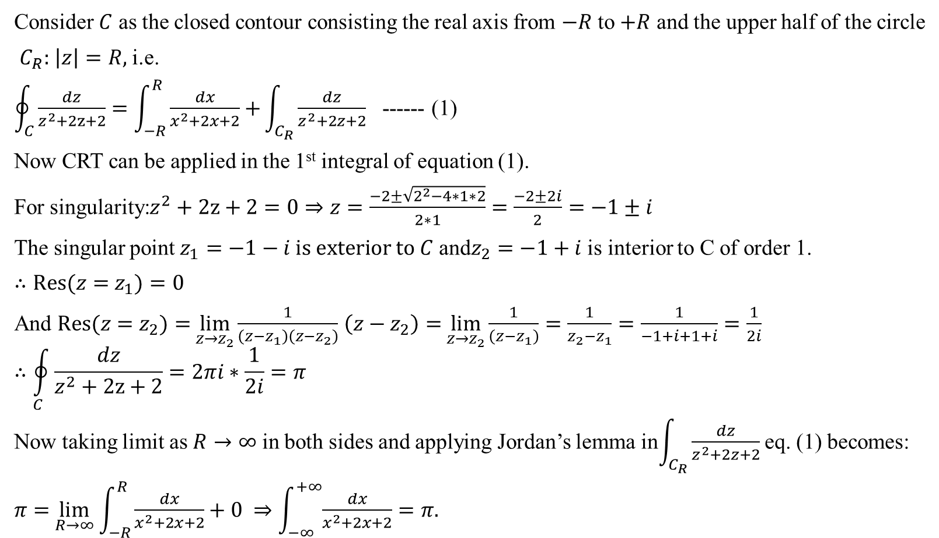
Problem: Evaluate $\int_{−∞}^{∞}{ \frac{dx }{x^{2}+2x+2}} using CRT.$
Consider $C$ as the closed contour consisting the real axis from $−R$ to $+R$ and the upper half of the circle
$C_{R}:$ $\left|z\right|=R,$i.e.
$\oint_{C}{\frac{dz}{z^{2}+2z+2}}=\int_{−R}^{R}{\frac{dx}{x^{2}+2x+2}+}\int_{C_{R}}{\frac{dz}{z^{2}+2z+2}}$ ------ (1)
Now CRT can be applied in the 1st integral of equation (1).
For singularity:$z^{2}+2z+2=0⇒z=\frac{−2±\sqrt{2^{2}−4∗1∗2}}{2∗1}=\frac{−2±2i}{2}=−1±i$
The singular point $z_{1}=−1−i is exterior to C$ and$z_{2}=−1+i$ is interior to C of order 1.
$∴Res(z=$ $z_{1})=0$
And $Res(z=$ $z_{2})=$ $\lim_{z→z_{2}}\frac{1}{\left(z−z_{1}\right)\left(z−z_{2}\right)}$ $\left(z−z_{2}\right)=$ $\lim_{z→z_{2}}\frac{1}{\left(z−z_{1}\right)}=\frac{1}{z_{2}−z_{1}}=\frac{1}{−1+i+1+i}=\frac{1}{2i}$
$$∴\oint_{C}{\frac{dz}{z^{2}+2z+2}}=2πi∗\frac{1}{2i}=π$$
Now taking limit as $R→∞$ in both sides and applying Jordan’s lemma in$\int_{C_{R}}{\frac{dz}{z^{2}+2z+2}}$ eq. (1) becomes:
$π=$ $\lim_{R→∞}$ $\int_{−R}^{R}{\frac{dx}{x^{2}+2x+2}+0} ⇒$ $\int_{−∞}^{+∞}{\frac{dx}{x^{2}+2x+2}}=π.$

Slide 7

Exercises: Evaluate the following improper integral using (CRT):
$\int_{−∞}^{∞}{ \frac{dx }{x^{2}+2x+5}}$
$\int_{0}^{∞}{ \frac{dx}{x^{2}+1}}$
$\int_{−∞}^{∞}{ \frac{x^{2}dx}{{\left(x^{2}+1\right)}^{2}}}$
$\int_{−∞}^{∞}{ \frac{dx}{{\left(x^{2}−2x+2\right)}^{2}} .}$

Slide 8
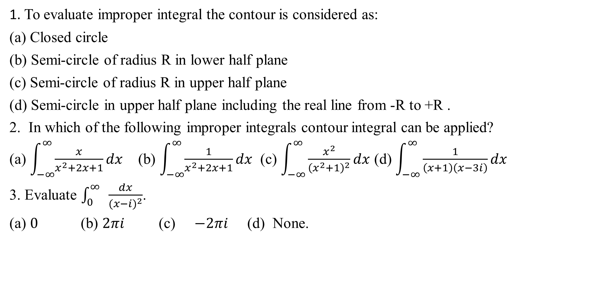
Sample MCQ:
1. To evaluate improper integral the contour is considered as:
(a) Closed circle
(b) Semi-circle of radius R in lower half plane
(c) Semi-circle of radius R in upper half plane
(d) Semi-circle in upper half plane including the real line from -R to +R .
2. In which of the following improper integrals contour integral can be applied?
(a) $\int_{−∞}^{∞}{\frac{x}{x^{2}+2x+1}}dx$ (b) $\int_{−∞}^{∞}{\frac{1}{x^{2}+2x+1}}dx$ (c) $\int_{−∞}^{∞}{\frac{x^{2}}{{\left(x^{2}+1\right)}^{2}}}dx$ (d) $\int_{−∞}^{∞}{\frac{1}{\left(x+1\right)\left(x−3i\right)}}dx$
3. Evaluate $\int_{0}^{∞}{ }\frac{dx}{{(x−i)}^{2}}$.
(a) $0$ (b) $2πi$ (c) $−2πi$ (d) None.

